Slide 1
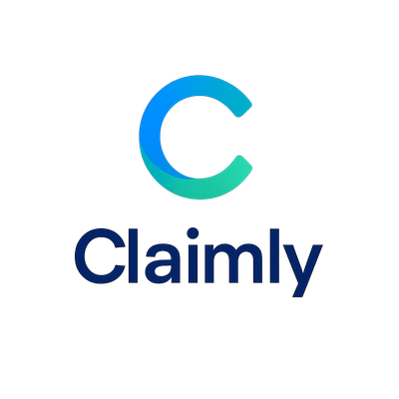
Claimly — Get It Done
AI-Powered Dental Insurance Claim Automation

Slide 2
Our Solution
• AI-powered dental x-ray analysis (FastAI + PyTorch)
• Auto-generated clinical notes
• Completed insurance claim forms
• Secure submission via clearinghouse APIs

Slide 3
How It Works
1. Upload X-ray
2. AI Diagnosis
3. Auto Notes
4. Submit Claim

Slide 4
The Problem
• Dental offices spend hours weekly preparing claims
• Approvals take weeks
• Rejections are common due to missing documentation

Slide 5
Market Opportunity
• $80B+ U.S. dental insurance market
• 200,000+ dental practices
• Huge potential for automation & faster reimbursement

Slide 6
Technology
• AI: FastAI + PyTorch image classification
• Backend: Django + REST APIs
• Document Generation: ReportLab
• HIPAA-ready compliance

Slide 7
Traction & Impact
• 80% faster claim preparation
• Approvals in 2–4 days instead of weeks
• Fewer rejected claims, cleaner submissions

Slide 8

Claimly Pitch Deck – Deck 3
Blockchain-Powered Payments Flow

Slide 9
Blockchain-Powered Payment Flow
Patient
Dental Office
Claimly AI
Insurance Blockchain
Fast Payment Release

Slide 10
Benefits of Blockchain Payments
• Real-time claim validation
• Faster payments to providers
• Patients experience reduced wait times
• Improved cash flow for dental practices
• Immutable audit trail for compliance

Slide 11
Business Model
• SaaS subscription per practice
• Per-claim automation fee (clearinghouse-integrated)
• Enterprise/DSO add-ons: analytics, SSO, SLAs

Slide 12
Competitive Landscape
• Traditional processors: manual, slow reimbursements
• Clearinghouses: limited AI, no payment acceleration
• Claimly: AI-driven claims + blockchain-accelerated payments

Slide 13
Get in Touch
Website: claimlyai.ai
Contact: investors@claimlyai.ai

